Slide 1
Parallel Programming
Exercise Session 11
<number>

Slide 2
Outline
Feedback: Assignment 10
Assignment 11
<number>

Slide 3
Feedback: Assignment 10
<number>
Notes:
<number>

Slide 4
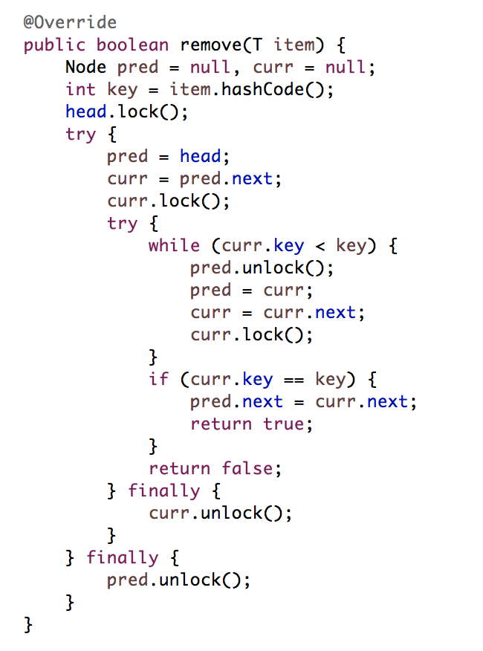
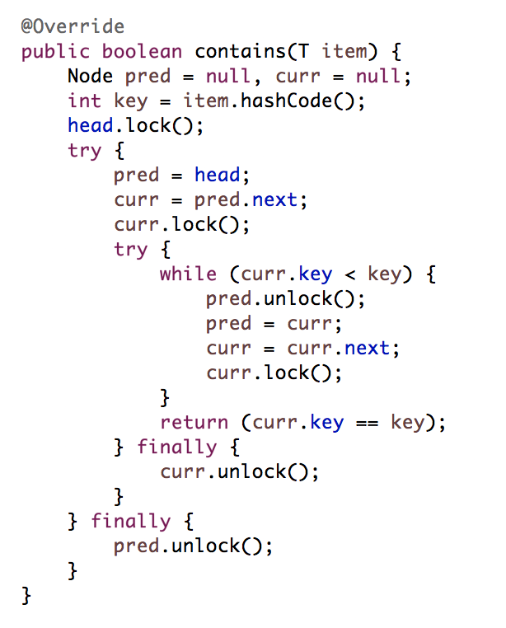
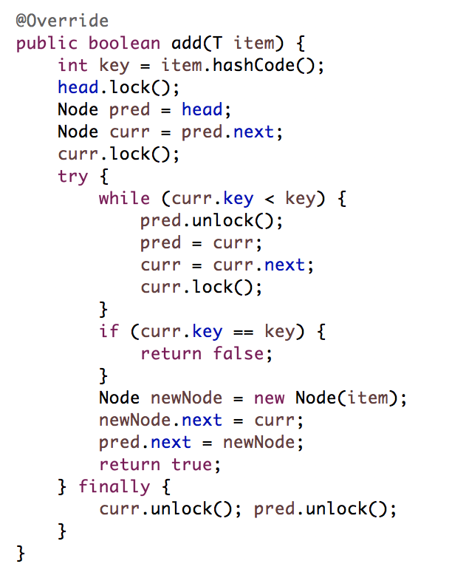
Fine grained Locking
<number>

Slide 5
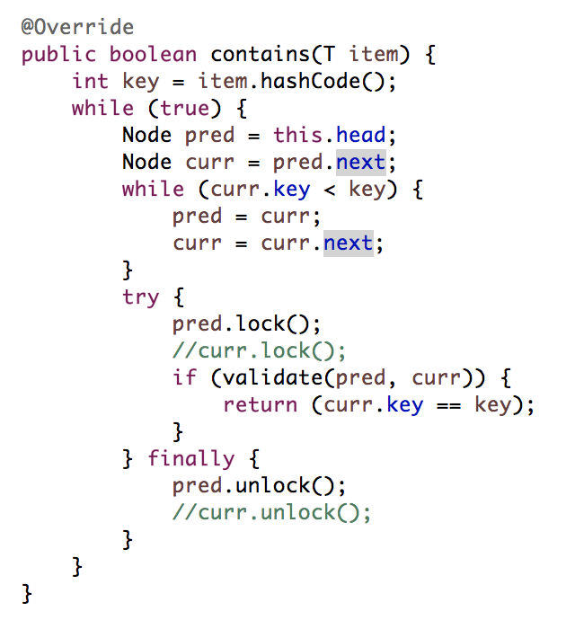
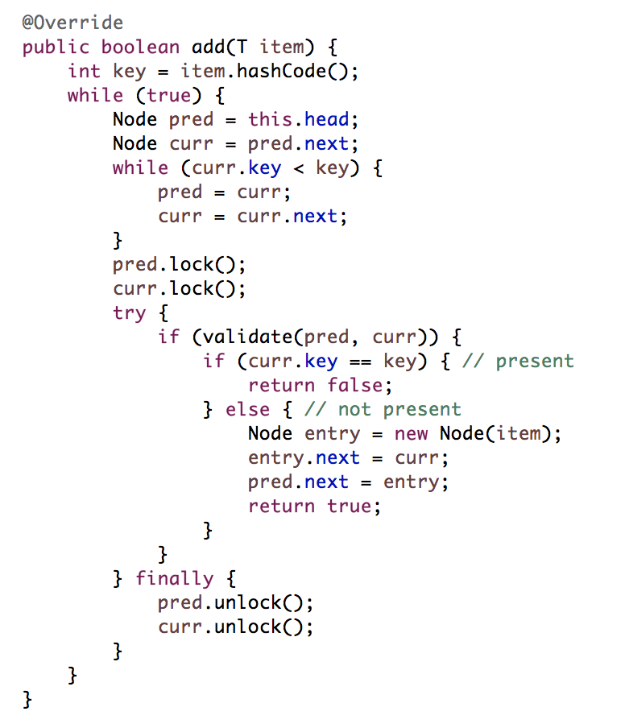
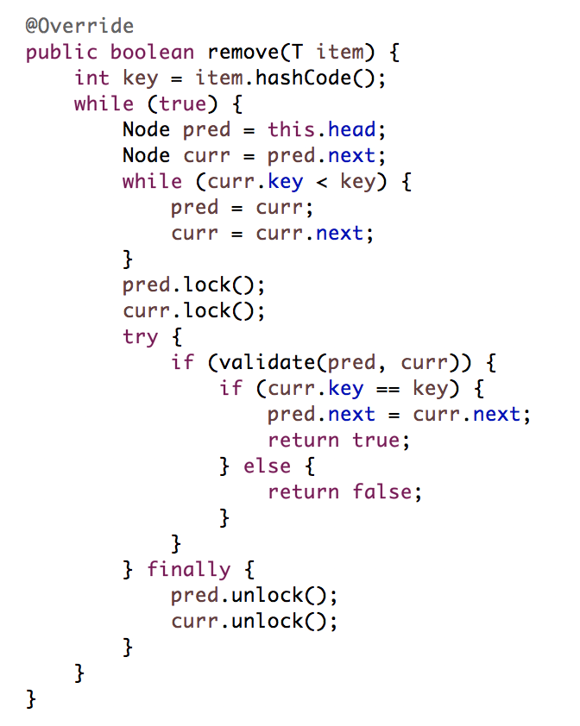
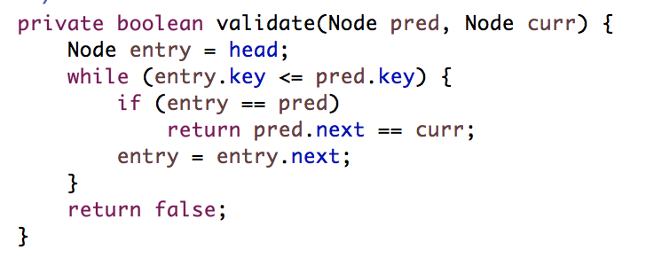
Optimistic Locking
<number>
Notes:
check equality after validation for contains:
“A thread is concurrently adding the element that you are looking for”

Slide 6
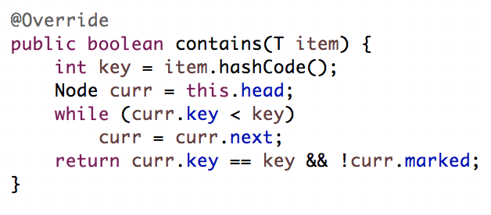
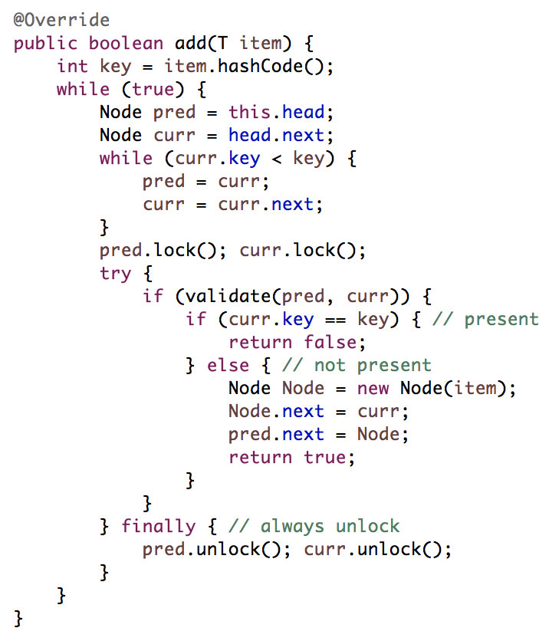
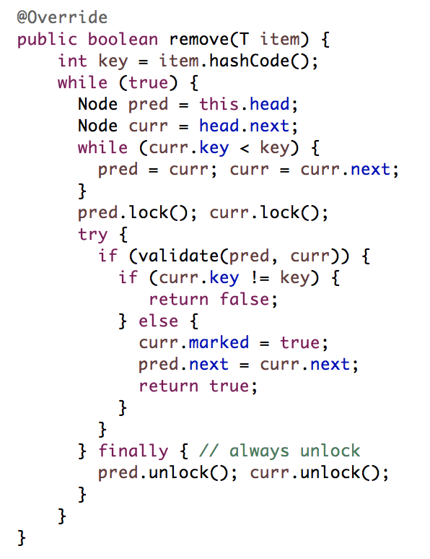
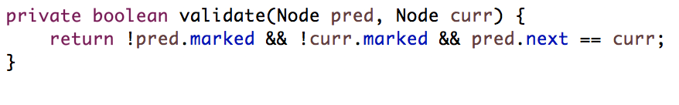
Lazy Locking
<number>

Slide 7
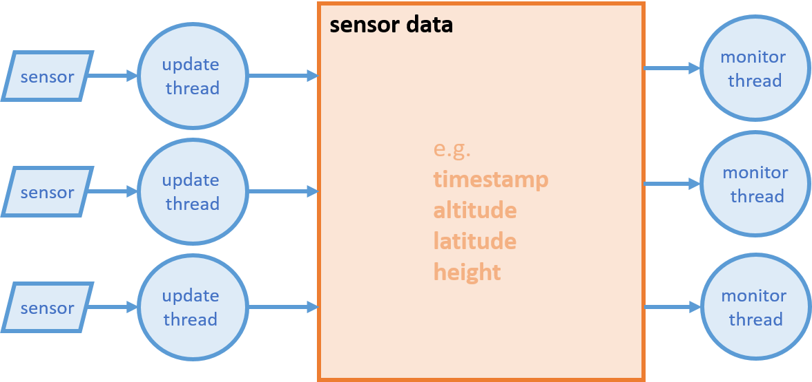
Assignment 11
  Multisensor System.
<number>

Slide 8
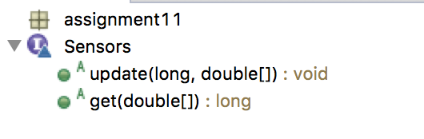
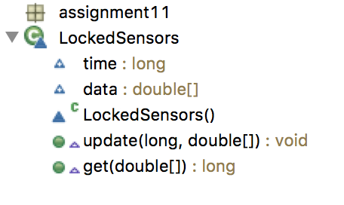
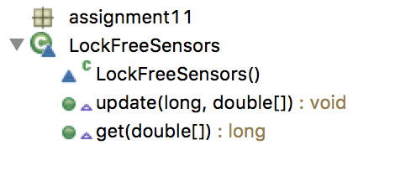
Multisensor System
<number>

Slide 9
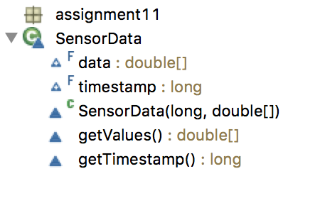
Multisensor System
<number>

Slide 10
Multisensor System
Implement two versions of the senor data set:
a) One blocking version based on a readers-writers lock (LockedSensors.java).
b) A lock-free version (LockFreeSensors.java)
Hints:
Before you implement the readers-writers lock based version, start with a simple locked version in order to understand. Then try a readers-writers lock but be aware that the Java-implementation does not give fairness guarantees. What can this imply? In any case, you have the code from the lecture slides presenting a fair RW-Lock implementation.
The lock-free implementation solutions does NOT rely on mechanisms such as Double-Compare- And-Swap. Also it does not rely on a lazy update mechanism. Somehow you have to make sure that with a single reference update you change all data at once. How?
<number>

Slide 11
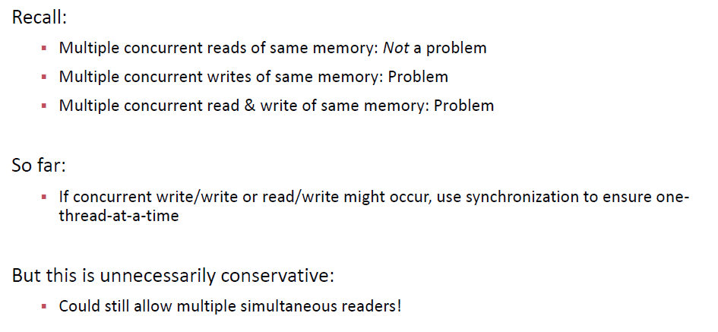
Readers-writers lock
<number>

Slide 12
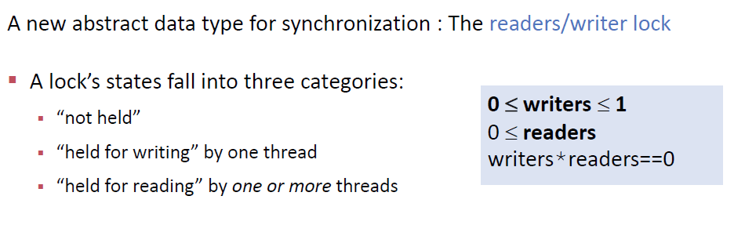
Readers-writers lock
<number>

Slide 13
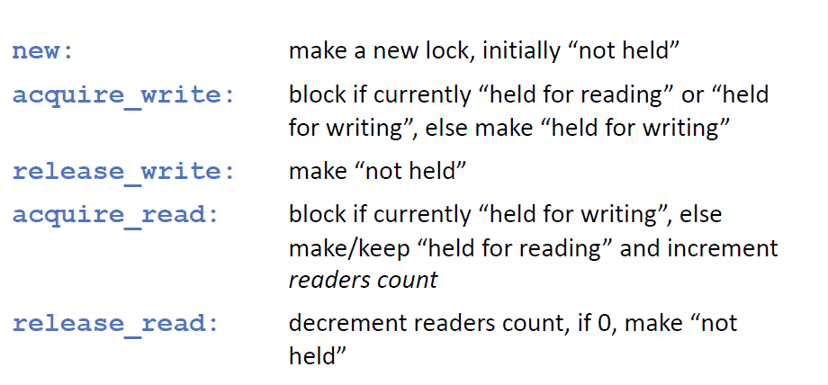
Readers-writers lock
<number>

Slide 14
Readers-writers lock in Java
No fairness guarantees!
double readSomething() {
readerWriterLock.readLock().lock();
try {
double value = retrieveDoubleValue();
return value;
} finally {
readerWriterLock.readLock().unlock();
}
}
Void writeSomething(double new_value) {
readerWriterLock.writeLock().lock();
try {
storeDoubleValue(new_value);
} finally {
readerWriterLock.writeLock().unlock();
}
}
<number>

Slide 15
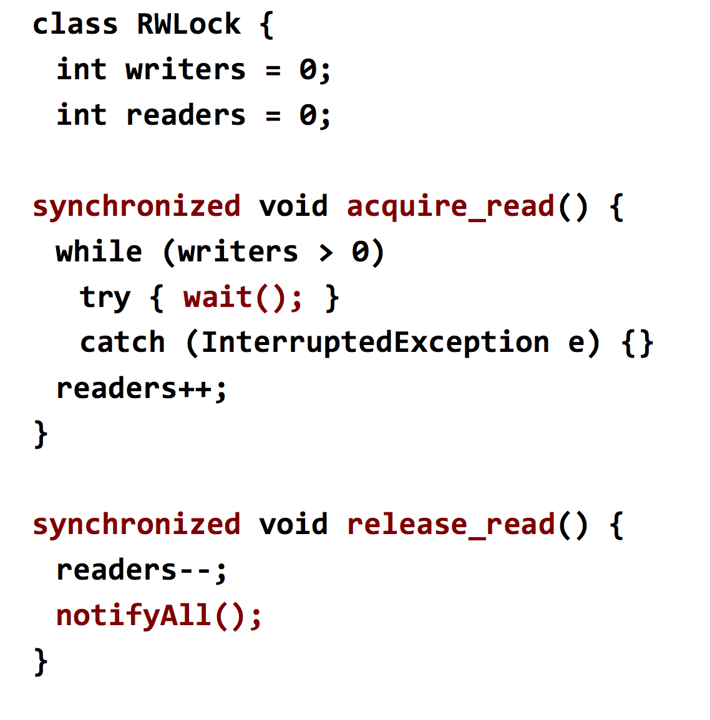
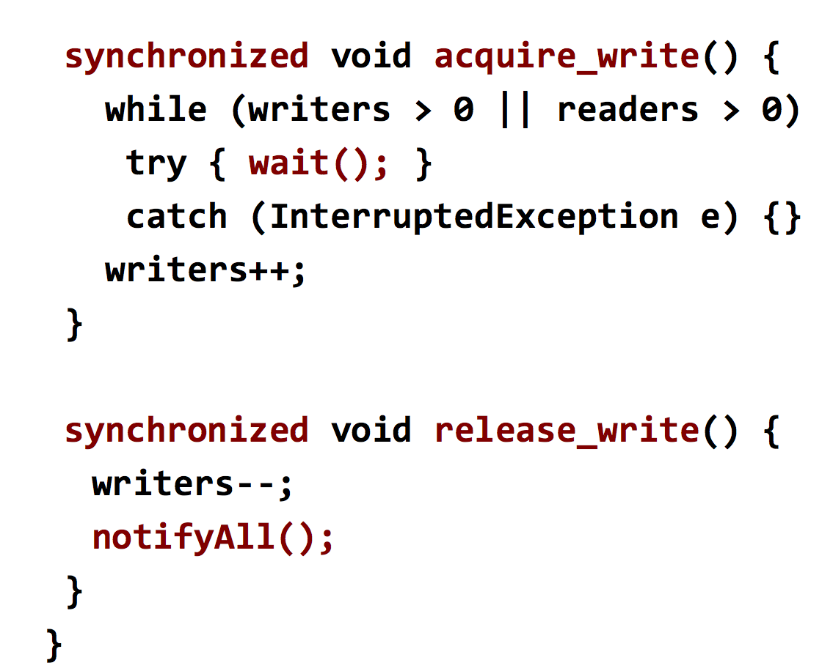
Readers-writers lock with monitors
<number>

Slide 16
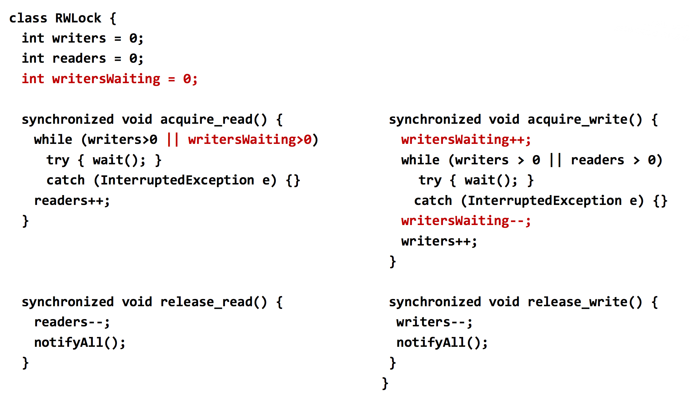
Readers-writers lock with monitors
<number>

Slide 17
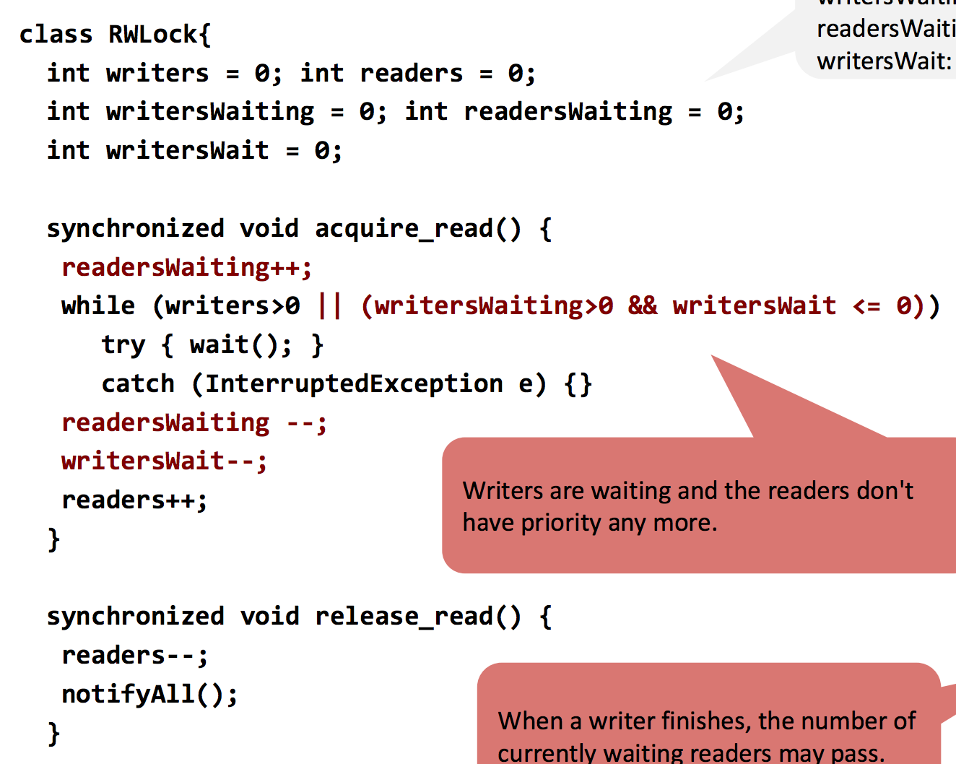
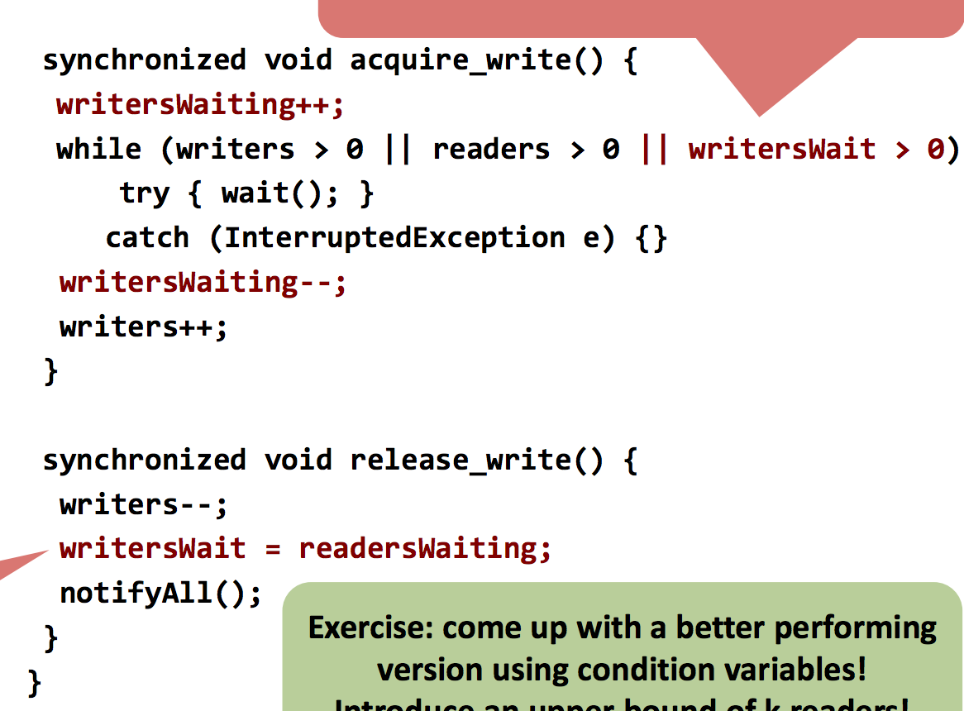
Readers-writers lock with monitors
<number>

Slide 18
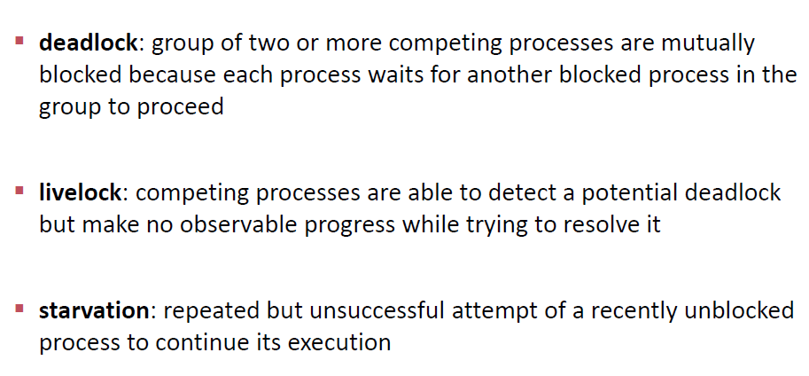
Problems with locks
<number>

Slide 19
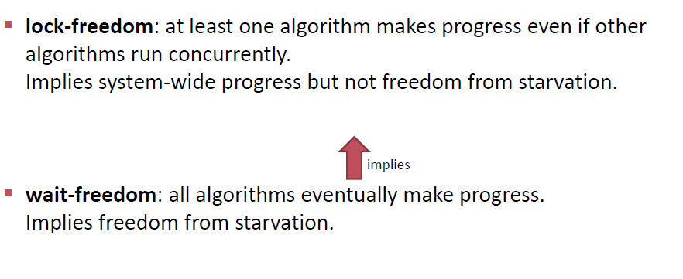
Lock free
<number>

Slide 20
Lock-free
Object readSomething() {
return atomicReference.get();
}
Void writeSomething(Object new_object) {
Object old_object;
do {
old_object = atomicReference.get();
// Check if we want to overwrite the latest data (i.e. only write newer or better data)
if ( … ) {
return;
}
} while (!atomicReference.compareAndSet(old_object, new_object));
}
<number>

